Slide 1

Asia Pacific College #3 Humabon Place, Magallanes Makati City September 08, 2016
Project: XERVE (Formerly: Foodtrip)

Slide 2
Project Title
Xerve (Formerly: Foodtrip)

Slide 3
Project Team Members
Tan, Jimmy
Zuñiga, Rouzzandra
Marquez, Iñigo
Felix, Andrepov

Slide 4
Project Overview
“Xerve” is a web/mobile application wherein you can easily discover and explore high class restaurants globally in cuisines with different cultures and whenever one selects a restaurant of his/her choice, detailed information can be viewed, feedback/comments and donation can be provided.

Slide 5
Introduction
Tired of exerting too much effort in spending time looking for restaurants in every corner of every street? then in the end, gaining the feeling of unsatisfaction? Worry no more! Since team FOODTRIP develops a new kind of application in which is user-friendly and hassle free, exclusively to those who have both the feeling of exhilaration and curiosity in exploring and discovering multitudes of unique and luxurious restaurants/cuisines worldwide. Team FOODTRIP calls it “Xerve”, a web/mobile app in which endorses, enhances, and easily searches these restaurant’s/cuisine’s digital profile for the convenience of quality food-craving consumers.

Slide 6
Problem Statement
The rise of fastfood chains and mediocre restaurants globally nowadays are having a rapid growth of attention and reputation and thus, luxurious cuisines are having difficulty in coping up with the level of their competitor’s growth in both attention and reputation.
On the other hand, food enthusiasts are experiencing boredom with continuously feasting through fastfoods and mediocre restaurants because they would have no easy means of locating luxurious cuisines.
Food enthusiasts do often hesitate in trying out luxurious cuisines due to lack of specific details about it.

Slide 7
Proposed Solution
Team FOODTRIP will be developing a simple yet user-friendly web/mobile app called “Xerve”, which expeditiously elevates the digital profile of restaurant establishments. This will also provide a unique yet efficient way of fulfilling the needs of food enthusiasts. It will mainly feature tracking and also informs the destination of a user’s preference regarding the type of cuisine chosen.

Slide 8
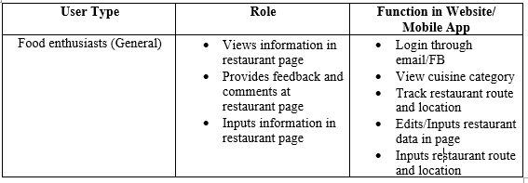
System Requirement Analysis

Slide 9
Functional System Specifications
Registration function (FB/Email)
Provide the users full access of the website
Users – Food enthusiasts (General)
Provides access for restaurant inputting and editing
Users – Food enthusiasts (General)
Drop-down cuisine category function
Provides the users access in choosing preferred cuisines
Users – Food enthusiasts (General)

Slide 10
Functional System Specifications
Gallery function
Promotes curiosity and cravings of a food enthusiast in viewing selected dishes
Users – Food enthusiasts (General)
Restaurant tracking function
Provides the exact GPS coordinates and nearby routes of specific restaurants/cuisines using Google maps and Waze
Users – Food enthusiasts (General)

Slide 11
Functional System Specifications
View Count function
Counts the number of users viewing the restaurants
Users – Food enthusiasts (General)
Feedback/Comment function
Gives users feedback/comment access in restaurants
Users – Food Enthusiasts (General)
Donation function
Gives users chance to provide donation for system upgrade, etc.
Users – Food enthusiasts (General)

Slide 12
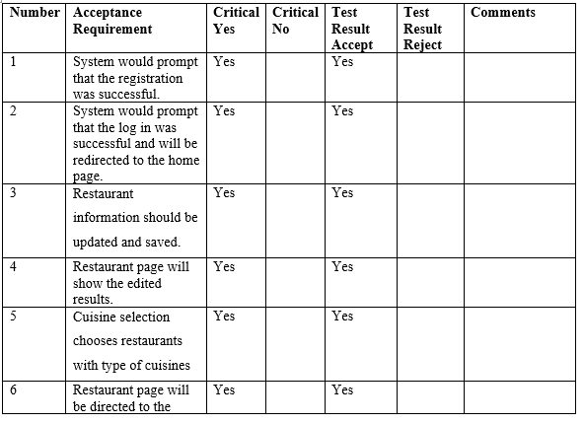
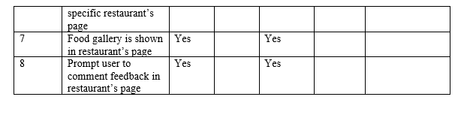
User Acceptance Testing

Slide 13
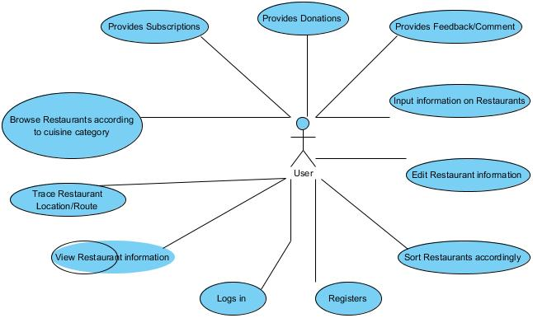
System Design
Use Case Tool Analysis

Slide 14
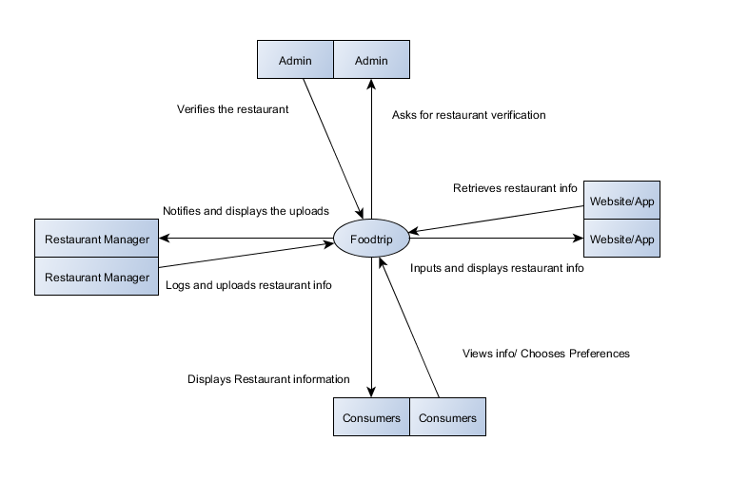
System Design
Context Level Diagram

Slide 15
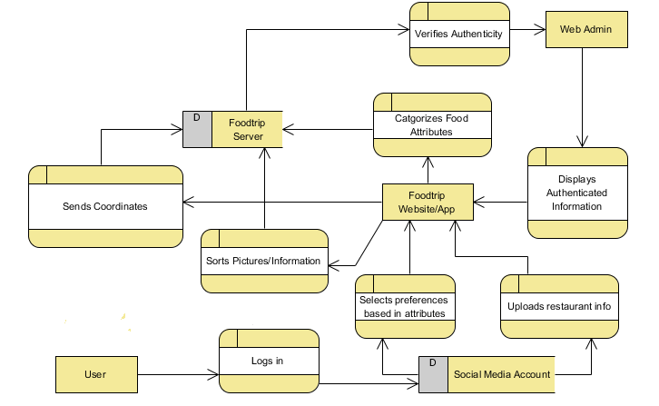
System Design
Data Flow Diagram

Slide 16
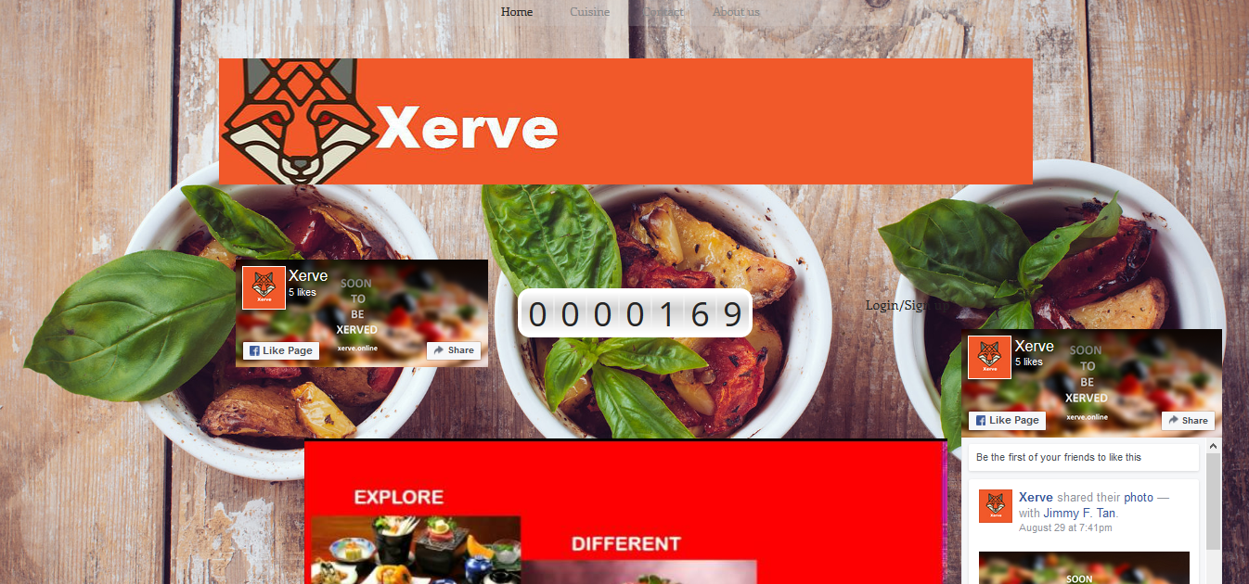
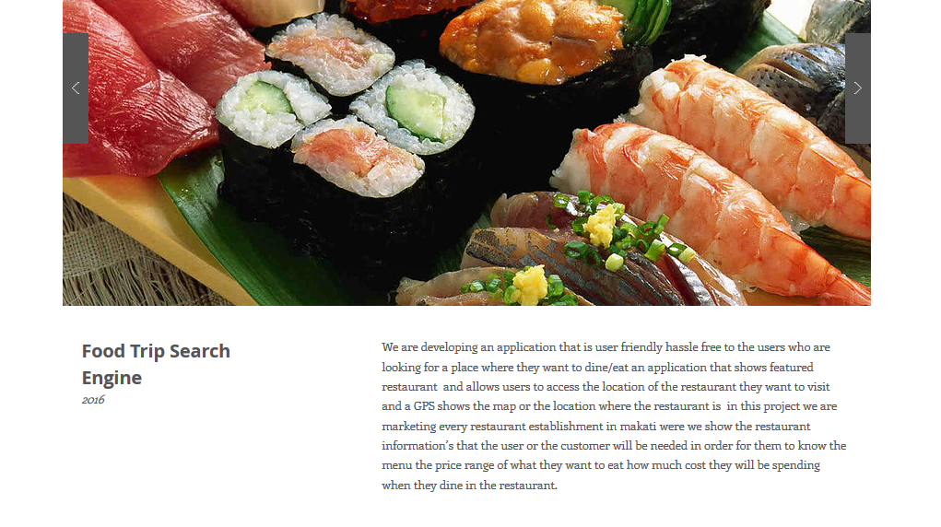
System Design
Screenshots Per Module
1.) Homepage
2.) About Us

Slide 17
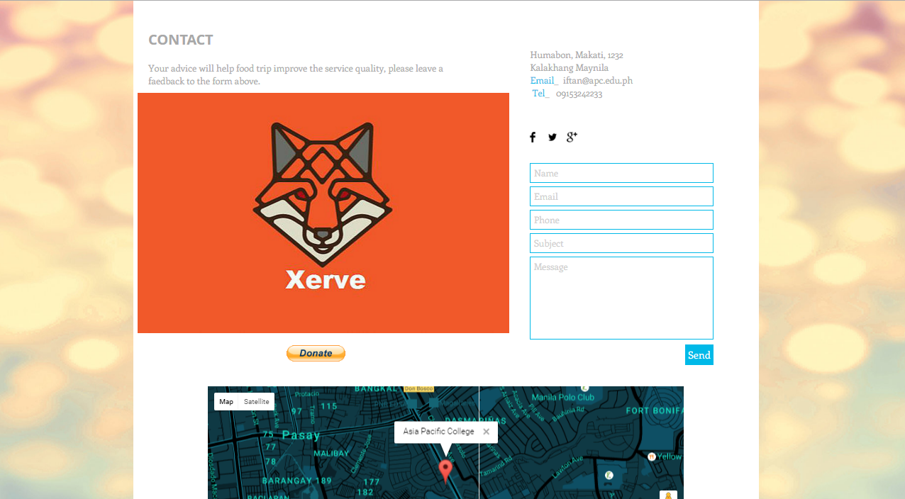

System Design
Screenshots Per Module
3.) Contact Us
4.) Visit Counter

Slide 18
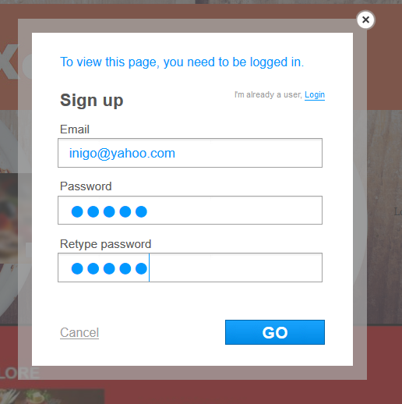
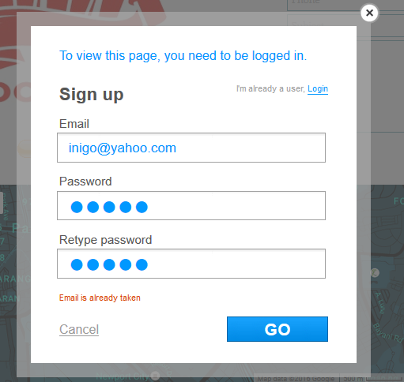
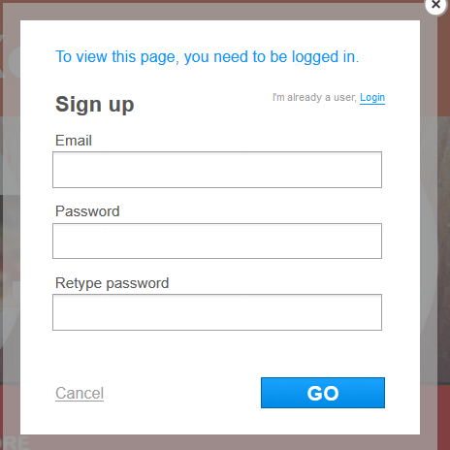
System Design
Screenshots Per Module
5.) Sign Up Form
6.) Signing Up
7.) Email Taken

Slide 19
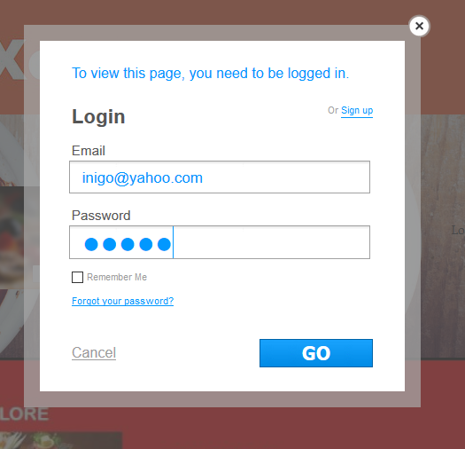
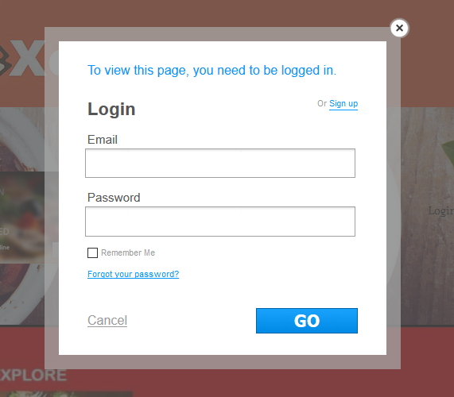
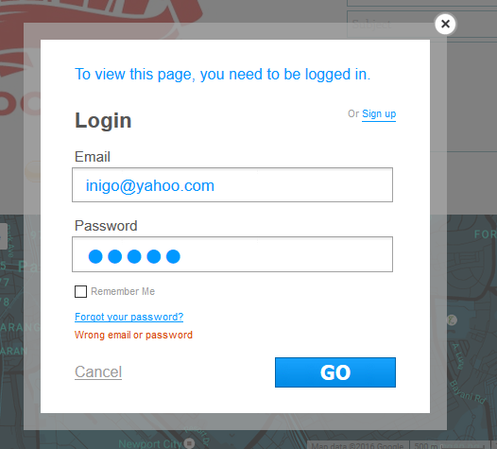
System Design
Screenshots Per Module
8.) Log in
9.) Logging in
10.) Wrong Enter

Slide 20
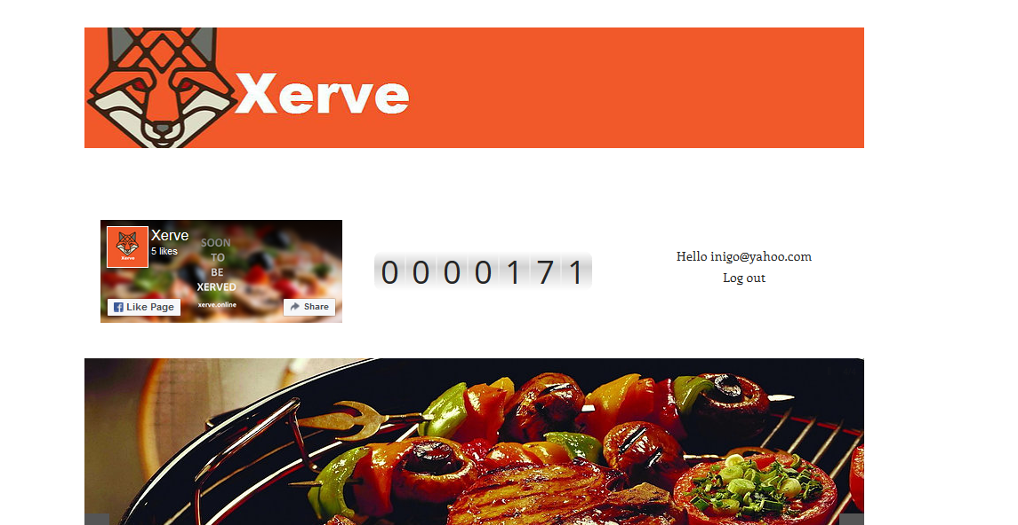
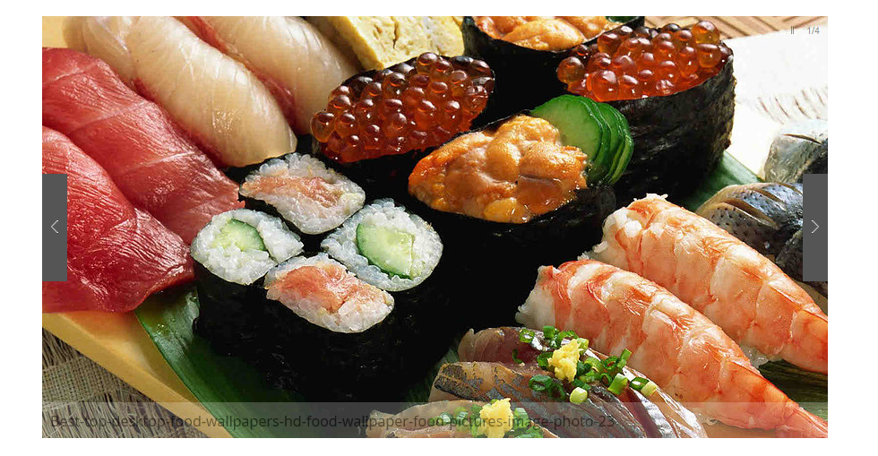
System Design
Screenshots Per Module
11.) Logged in
12.) Sliding Images

Slide 21
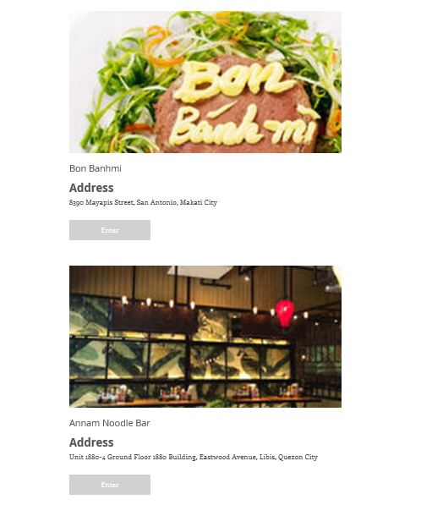
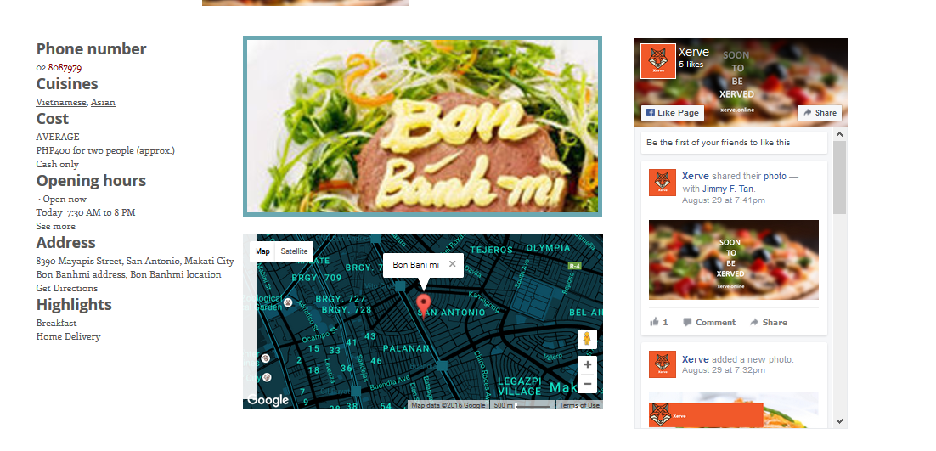
System Design
Screenshots Per Module
13.) Chosen Cuisine Selection
14.) Cuisine Information

Slide 22

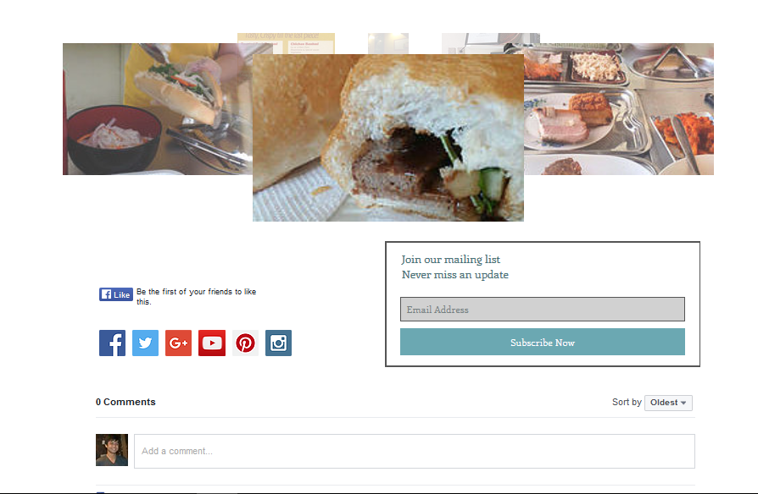
System Design
Screenshots Per Module
15.) Xerve FB Page
16.) Subscription
17.) Social Media Sharing
18.) Comment
19.) Gallery

Slide 23
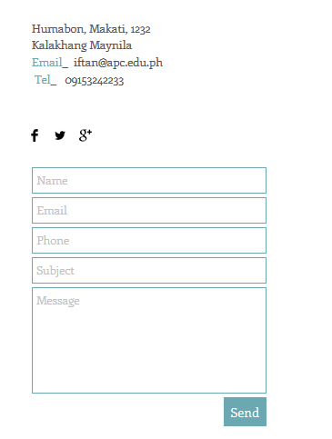
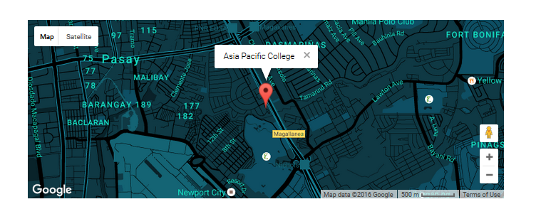
System Design
Screenshots Per Module
20.) Google Map
21.) Feedback Form

Slide 24
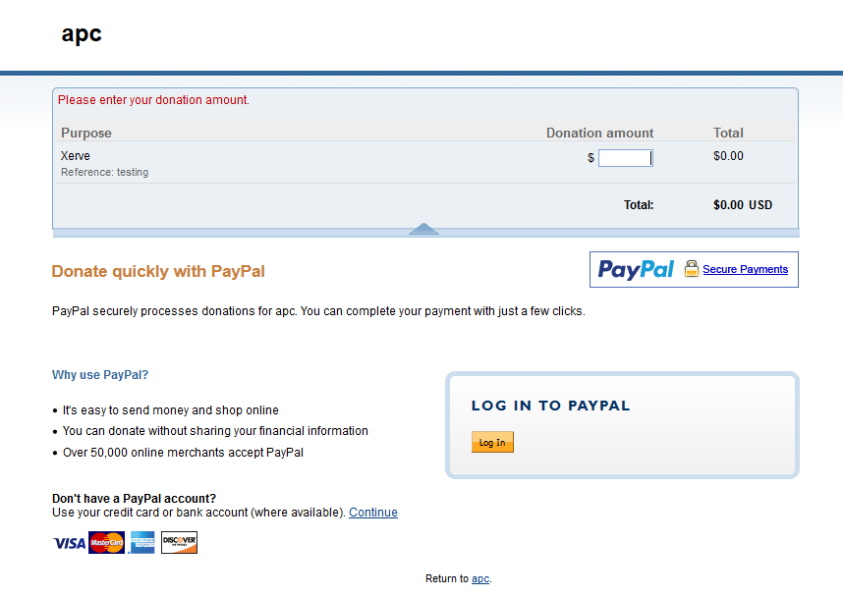
System Design
Screenshots Per Module
22.) Donation Function

Slide 25
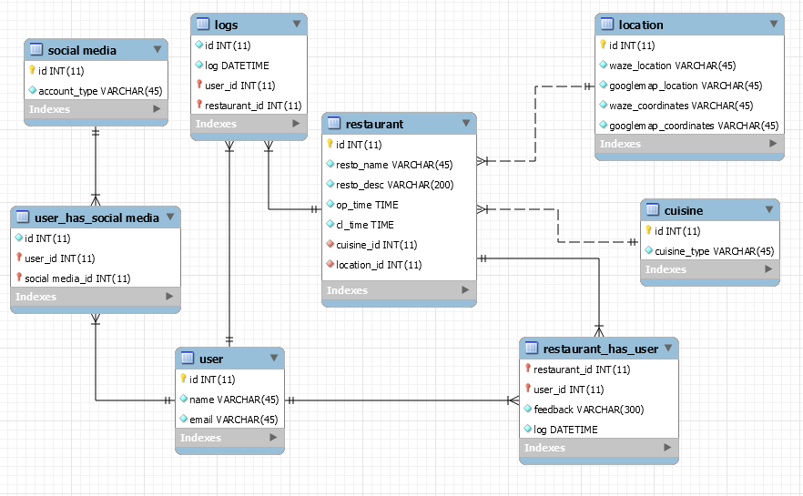
System Design
Entity Relationship Diagram

Slide 26
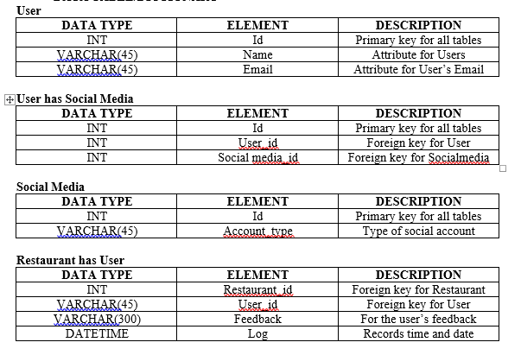
System Design
Data Table/Dictionary

Slide 27
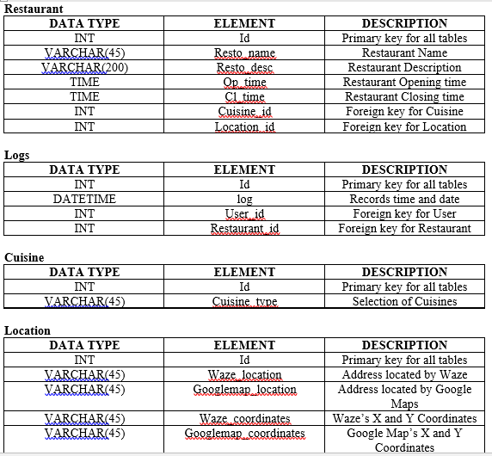
System Design
Data Table/Dictionary

Slide 28
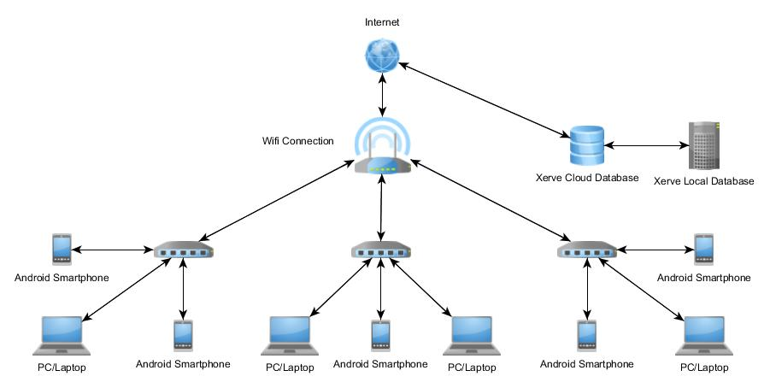
System Design
Network Diagram

Slide 29
System Configuration
Software Environment
This section lists the requirements that are needed to run the system efficiently:
Programming Languages:
The application will be developed using Java, HTML5, PHP, Mobile framework
Specific Software:
Xerve uses the MySql Database to store data and it is connected to cloud server and Android Studio
Operating System:
The application runs in Android Operating System. Android API level 19 kit Kat and Google Chrome Web Browser and will operate in any Windows Operating System such as Windows 7, Windows 8/8.1, and Windows 10.

Slide 30
System Configuration
Hardware Environment
Xerve will be providing minimum hardware requirements. The following are required:
Device: Android Smartphone
System Type: Android 4.4 (Kitkat) API 19
Processor: 1.3 GHz Processor
RAM: at least 1 GB of RAM
Device: Laptop/Desktop
System Type: Windows OS/ Mac OS
Processor: Intel/AMD
RAM: 512MB of RAM

Slide 31
System Configuration
Networking and Security
Security – SSL (Secure Socket Layer)
Server – Local Server/Cloud

Slide 32
Conclusion
By the creation and development of “Xerve”, Food enthusiasts are now guaranteed to gain complete knowledge in terms of the following:
Restaurant/Cuisine locations and routes.
Restaurant/Cuisine dish prices.
Restaurant/Cuisine descriptions.
Unexplored restaurants/cuisines.
Hidden restaurants/cuisines.
Since the following are now solved, this application therefore shows how it is to be easy for people to experience the highest level of fun, excitement, and adrenaline rush in exploring different varieties and qualities of food in a global scale.

Slide 33
References
Zomato – https://www.zomato.com/manila
OpenRice - http://www.openrice.com/en/hongkong

